Slide 1
ELECTRONIC STRUCTURE OF STRONGLY CORRELATED SYSTEMS
G.A.SAWATZKY
UBC PHYSICS & ASTRONOMY
AND CHEMISTRY
Max Planck/UBC center for Quantum Materials

Slide 2
Some Historical Landmarks
1929-1931 Bloch Wilson theory of solids
1937 De Boer and Verwey ( NiO-CoO breakdown of band theory
1937 Peierls 3d electrons avoid each other ( basically the Hubbard model)
1949 Mott Metal insulator transition
1950 Jonker, van Zanten, Zener - Pervoskites double exchange
1957 BCS theory of superconductivity
1958 Friedel Magnetic impurities in metals
1959 Anderson superexchange (U>>W)
1962 Anderson model for magnetic impurities in metals
1964 Kondo theory of Kondo effect
1964 Hubbard model- Hohenberg Kohn DFT- Goodenough Transition metal compounds

Slide 3
Some historical landmarks
1964 Hohenberg Kohn density functional theory and Kohn Sham application to band theory
1964 Goodenough basic principles of transition metal compounds
1965 Goodenough Kanamori Anderson rules for superexchange interactions
1968 Lieb and Wu exact solution of 1D Hubbard model
1972 Kugel Khomskii theory of orbital ordering
1985 Van Klitzing quantum Hall effect
1985 ZSA classification scheme of transition metal compounds
1986 Bednorz and Muller High Tc superconductors
1988 Grunberg and Fert giant magneto resistance

Slide 4
It’s the outermost valence electron states that determine the properties
Both the occupied and unoccupied ones

Slide 5
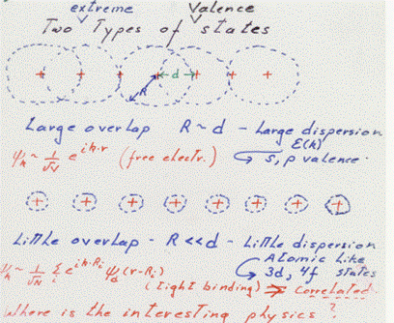
Two extremes for atomic valence states in solids
Where is the interesting physics?
Coexistance-----Hybridization
Kondo, Mixed valent, Valence fluctuation, local moments, Semicond.-metal transitions, Heavy Fermions, High Tc’s, Colossal magneto resistance, Spin tronics, orbitronics

Slide 6
Extreme valence orbitals
Recall that the effective periodic corrugation of the potential due to the nuclei screened by the “core” electrons is very small for R>>D leading to free electron like or nearly free electron like behavior.
For R<<D the wave functions are atomic like and feel the full corrugation of the screened nuclear potentials leading to quantum tunneling describing the motion of tight binding like models. ATOMIC PHYSICS IS VERY IMPORTANT

Slide 7
Characteristics of solids with 2 extreme valence orbitals
R>> D
R<<D
electrons lose atomic identity
Form broad bands
Small electron electron interactions
Low energy scale –charge fluctuations
Non or weakly magnetic
Examples Al, Mg, Zn, Si
Valence Electrons remain atomic
Narrow bands
Large electron electron interactions (on site)
Low energy scale-spin fluctuations
Magnetic (Hunds’ rule)
Gd, CuO, SmCo3
Many solids have coexisting R>>D and R<<D valence orbitals i.e. rare earth 4f and
5d, CuO Cu 3d and O 2p, Heavy Fermions, Kondo, High Tc,s , met-insul. transitions

Slide 8
Strongly correlated materials
Often 3d transition metal compounds
Often Rare earth metals and compounds
Some 4d, 5d and some actinides
Some organic molecular systems C60, TCNQ salts
Low density 2D electron gases Quantum and fractional quantum Hall effect
Strong magnetism is often a sign of correlation

Slide 9
Wide diversity of properties
Take for example only the transition metal oxides
Metals: CrO2, Fe3O4 T>120K
Insulators: Cr2O3, SrTiO3,CoO
Semiconductors: Cu2O
Semiconductor –metal: VO2,V2O3, Ti4O7
Superconductors: La(Sr)2CuO4, LiTiO4, LaFeAsO
Piezo and Ferroelectric: BaTiO3
Multiferroics
Catalysts: Fe,Co,Ni Oxides
Ferro and Ferri magnets: CrO2, gammaFe2O3
Antiferromagnets: alfa Fe2O3, MnO,NiO ---
Properties depend on composition and structure in great detail

Slide 10
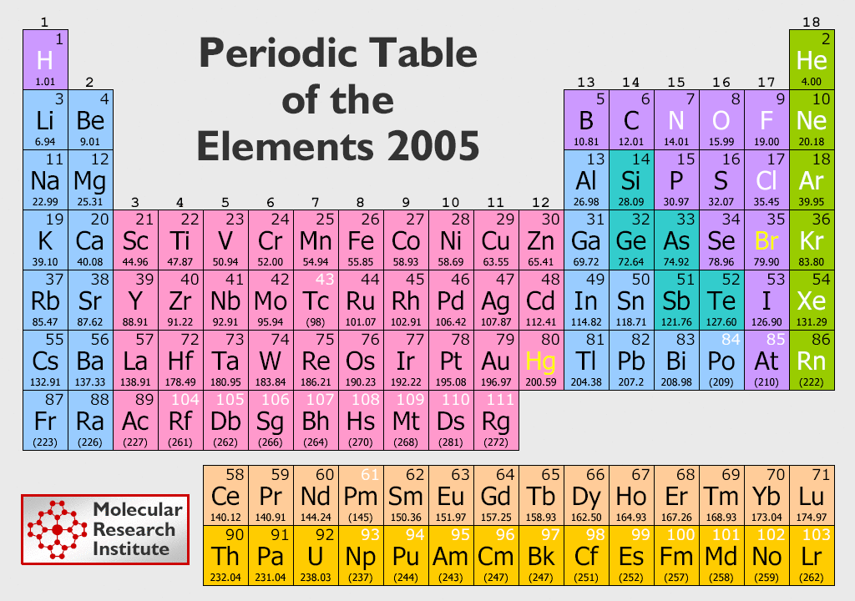

Slide 11
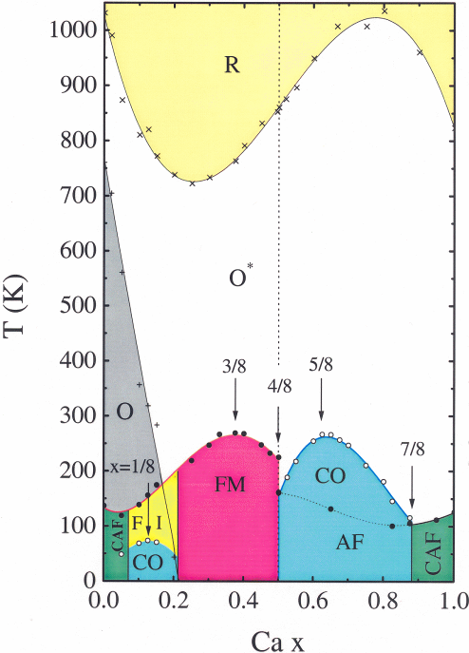
Phase Diagram of
La_{1-x}Ca_{x}MnO₃
Uehara, Kim and Cheong
R: Rombohedral
O: Orthorhombic
(Jahn-Teller distorted)
O*: Orthorhombic
(Octahedron rotated)
CAP = canted antiferromagnet
FI = Ferromagnetic Insulator
CO = charge ordered insulator
FM= Ferromagnetic metal
AF= Antiferromagnet

Slide 12
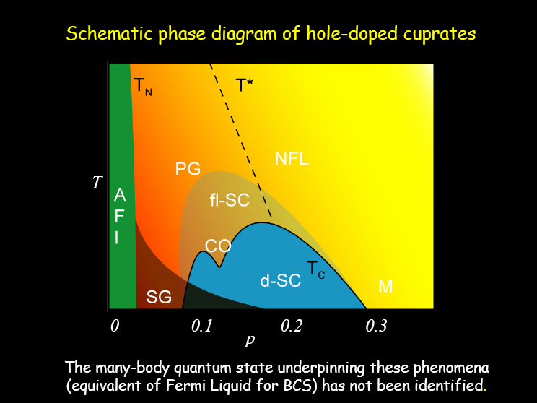
High Tc superconductor phase diagram

Slide 13
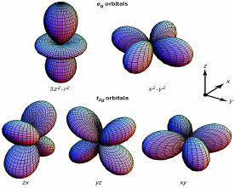
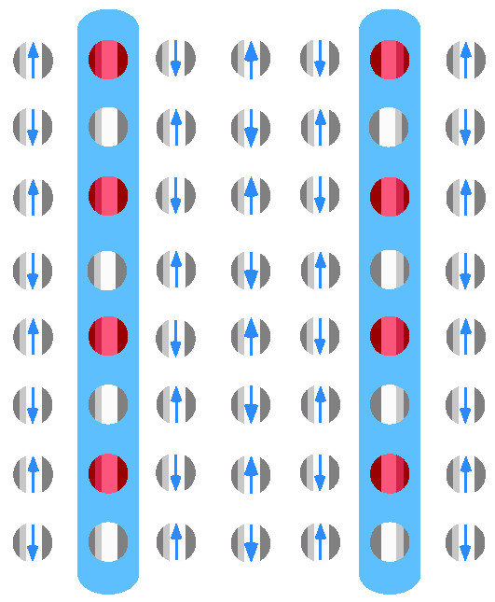
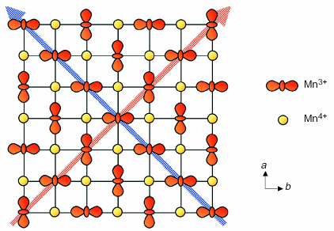
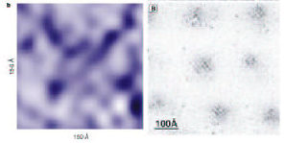
Ordering in strongly correlated systems
Stripes in Nd-LSCO
rivers of
Charge—
Antiferro/
Antiphase
ΔQ < 0.5 e
Quadrupole moment ordering
ΔQ_{C} ~ 1 e
ΔQ_{O} ~ 0
Charge inhomogeneity in Bi2212
Pan, Nature, 413, 282 (2001);
Hoffman, Science, 295, 466 (2002)
ΔQ ~ 0.1 e

Slide 14
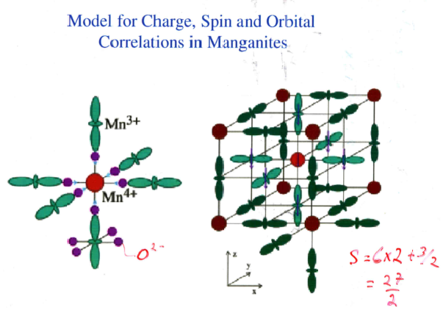
Mizokawa et al PRB 63, 024403 2001
Mn4+ , d3, S=3/2 ,No quadrupole ; Mn3+, S=2, orbital degeneracy

Slide 15
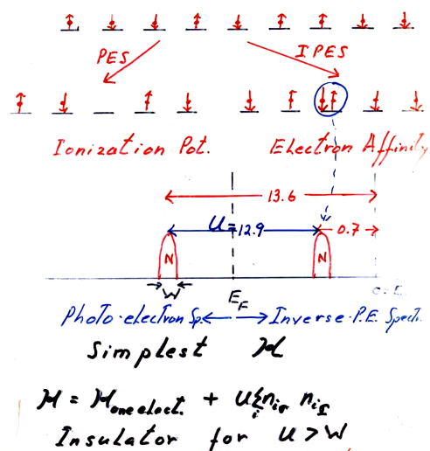
Simplest model single band Hubbard
Row of H atoms
1s orbitals only
Largest coulomb
Interaction is on site
U
The hole can freely
Propagate leading to
A width
The electron can freely
Propagate leading to a width
E gap = 12.9eV-W
The actual motion of the
Particles will turn out to be
more complicated

Slide 16
For large U>>W
One electron per site ----Insulator
Low energy scale physics contains no charge fluctuations
Spin fluctuations determine the low energy scale properties
Can we project out the high energy scale?
Heisenberg Spin Hamiltonian

Slide 17
Spectral weight transfer
The real signature of strong correlation effects

Slide 18
Doping a Mott – Hubbard system
U
N
N
PES
E_{F}
PES
(1-x)/2x
N-1
N-1
N+1
2
N-1
2
E_{F}
E_{F}
Meinders et al, PRB 48, 3916 (1993)

Slide 19
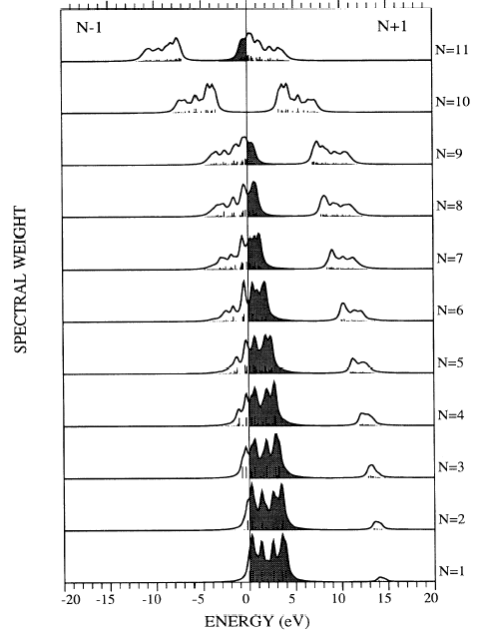
In single particle mean field theory states move with doping since the
average coulomb interaction changes. In correlated electron systems states stay
Fixed but spectral weight gets transferred
x=0.0
x=0.1
x=0.2
x=0.3
x=0.4
x=0.5
x=0.6
x=0.7
x=0.8
These states would
be visible in a two
particle addition
spectral function
x=0.9
Meinders et al, PRB 48, 3916 (1993)

Slide 20
Why are 3d and 4f orbitals special
Lowest principle q.n. for that l value
Large centrifugal barrier l=2,3
Small radial extent, no radial nodes orthogonal to all other core orbitals via angular nodes
High kinetic energy ( angular nodes)
Relativistic effects
Look like core orb. But have high energy and form open shells like valence orb.

Slide 21
A bit more about why 3d and 4f are special as valence orbitals
Hydrogenic orbital energy non relativistic
Relativistic contribution
3d of Cu; binding energy of 3s=120 eV, 3p=70 eV, 3d=10 eV.
Strong energy dependence on l due to relativistic effects.

Slide 22
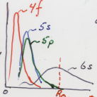
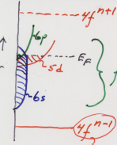
Highly confined orbitals will have a large U
Charge density of outer orbitals of the
Rare earths
Atomic radius in solids
Elemental electronic configuration of rare earths
A rare earth metal
For N<14 open shel
5d6s form a broad conduction
Band
Hubbard for 4f
Hubbard U
4f is not full and not empty

Slide 23
Band Structure approach vs atomic
Band structure
Atomic
Delocalized Bloch states
Fill up states with electrons starting from the lowest energy
No correlation in the wave function describing the system of many electrons
Atomic physics is there only on a mean field like level
Single Slater determinant states
Local atomic coulomb and exchange integrals are central
Hunds rules for the Ground state -Maximize total spin-Maximize total angular momentum-total angular momentum J =L-S<1/2 filled shell , J=L+S for >1/2 filled shell
Mostly magnetic ground states

Slide 24
DFT and band theory of solids
The many electron wave function is assumed to be a single Slater determinant of one electron Bloch states commensurate with the periodic symmetry of the atoms in the lattice and so has no correlation in it
The single particle wave functions φ
contain the other quantum
numbers like atomic nlm and spin.
k represents the momentum vector
The effects of correlation are only in the effective
one particle Hamiltonian. NO CORRELATION IN THE
WAVE FUNCTION

Slide 25
Configuration interaction approach
The one electron wave functions in ψ atomic do not possess the symmetry of the lattice which in chemistry is called a broken symmetry ansatz. To include intersite hoping perturbatively we consider mixing in electron configurations with now empty sites and others with two electrons on a site.
t
t=nn hoping integral
Energy =U
Mixing in of this excited state wave function amplitude = t/U But
there are an infinite Number of these virtual excitations in a
configuration interaction approach.

Slide 26
General band theory result for R<<d together with R>>d states
For open shell bands R<<d R<<d so bands are narrow
open thereforE must be at Ef

Slide 27
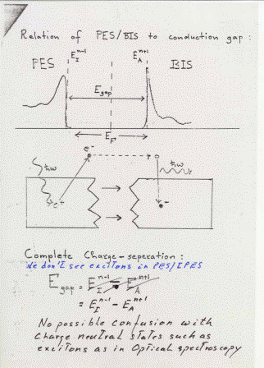
What do we mean by the states below and above the chemical potential
The eigenstates of the system with one electron removed or one electron added respectively i.e Photoelectron and inverse photoelectron spectroscopy
IPES
N-1
N+1

Slide 28
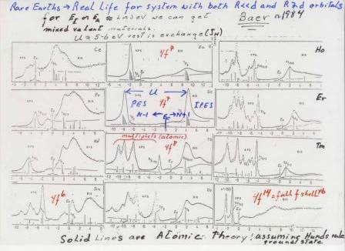
Photoelectron spectroscopy of the rare earths

Slide 29
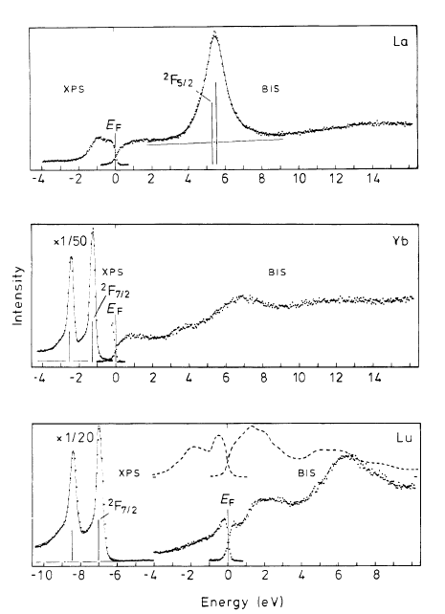
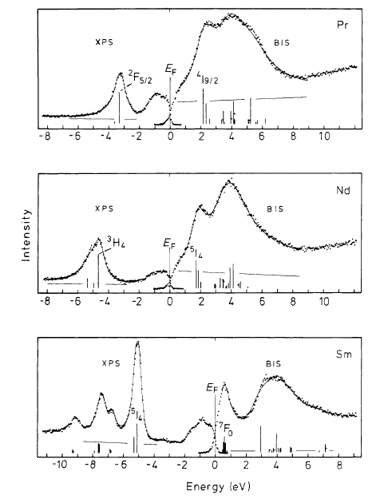
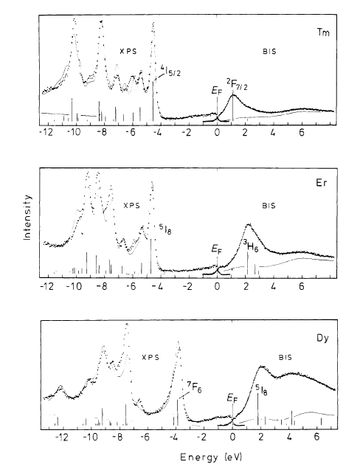
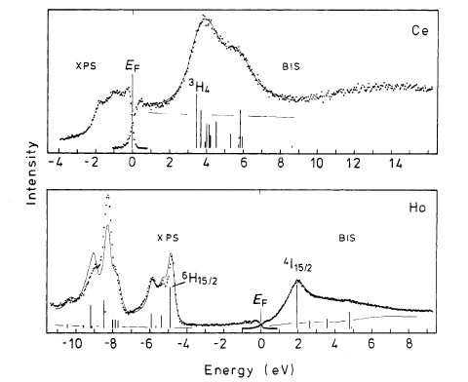
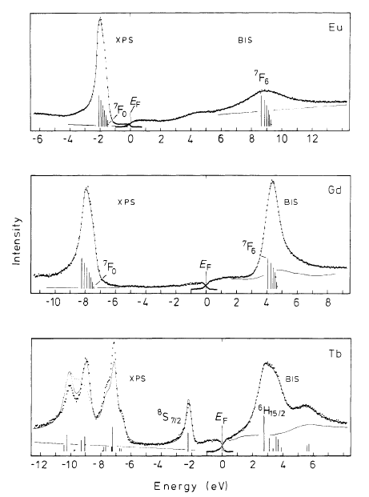
Photo and inverse Photo electron spectra of the rare earth
Metals (Lang and Baer (1984)). 0 is EFermi
Solid vertical lines are atomic multiplet theory
U

Slide 30
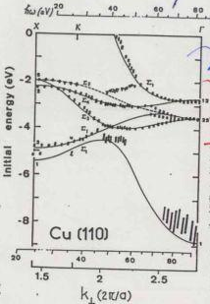
Angular resolved photoelectron spectroscopy (ARPES) of Cu metal
Thiry et al 1979
ARPES Cu
Points –exp.
Lines - DFT
Cu is d10 so one d hole
Has no other d holes to
Correlate with so 1 part.
Theory works FOR N-1
if the only Important
interaction isthe d-d
interaction.
3d bands
4s,4p,band

Slide 31
We note that for Cu metal with a full 3d band in the ground state one particle theory works well to describe the one electron removal spectrum as in photoelectron spectroscopy this is because a single d hole has no other d holes to correlated with. So even if the on site d-d coulomb repulsion is very large there is no phase space for correlation.
The strength of the d-d coulomb interaction is evident if we look at the Auger spectrum which probes the states of the system if two electrons are removed from the same atom
If the d band had not been full as in Ni metal we would have noticed the effect of d-d coulomb interaction already in the photoemission spectrum as we will see.

Slide 32
What if we remove 2- d electrons locally?
Two hole state with Auger spectroscopy
Auger electron
Photoelectron
Photon
3d
Example is for Cu with
A fully occupied 3d band
2p
932eV
E(photon)-E(photoelectr) = E(2p) , E (2-d holes)= E(2p)-E(3d)-E(Auger)
U = E( 2-d holes) -2xE(1-d hole)

Slide 33
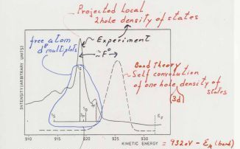
Auger spectroscopy of Cu metal
Atomic multiplets
Looks like gas phase
U>W
Two hole bound states
Hund’s rule
Triplet F is
Lowest
The L3M45M45 Auger spectrum of Cu metal i.e final state has 2 -3d holes on the
Atom that started with a 2p hole. Solid line is the experiment. Dashed line is one
Electron DFT theory, vertical bars and lables are the free atom multiplets for 8- 3d
electrons on a Cu atom . Ef designates the postion of the Fermi level in the DFT .
Antonides et al 1977
Sawatzky theory 1977

Slide 34
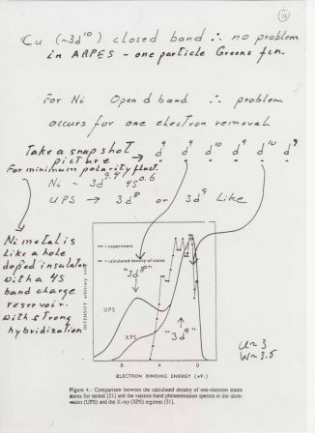
Removal from d9 states
Will be U higher in energy
Taken from Falicov 1987

Slide 35
Sometimes we get so involved in the beauty and complexity of the model that we forget what the validating conditions were and use them outside of the range of validity
Regarding simple models
Like sinple band Hubbard

Slide 36
Closer to real systems
We use mainly 3d transition metal compounds as examples
More than only spin and charge play a role here
Orbital degrees of freedom in partly occupied d orbitals interact with spin and charge degrees of freedom
We have to deal with multi band systems

Slide 37
Interplay between spin, charge, lattice and orbital degrees of freedom
In the large U limit where polarity fluctuations are strongly suppressed in the low energy scale physics THE PHYSICS OF ATOMS AND IONS IN LOWER THAN SPHERICAL SYMMETRY PLAYS AN IMPORTANT ROLE
We now deal with crystal and ligand field splittings, Hund’s rule coupling , spin orbit coupling, superexchange interactions, and the role of orbital degeneracy

Slide 38
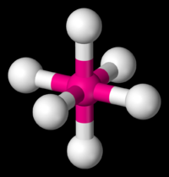
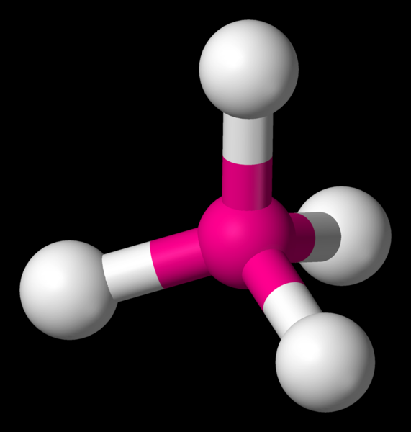
Some typical coordinations of TM ions
Octahedral coordination
Red=TM ion
White =Anion like O2-
Tetrahedral coordination
Red = TM
White =anion like O2-
As in NiO
As in LiFeAs

Slide 39
Free atom d wave function
For d states l=-2; m=-2,-1,0,1,2; and for 3d n=3
With spin orbit coupling j=l+s or j=l-s s=spin =1/2
Spin Orbit λ~ 40 -100 meV for 3d and about 3 times larger for 4d
For 3d’s the orbital angular momentum is often quenched because λ<< crystal field. THIS IS NOT THE CASE FOR ORBITALLY DEGENERATE T2g states here spin orbit is always important

Slide 40
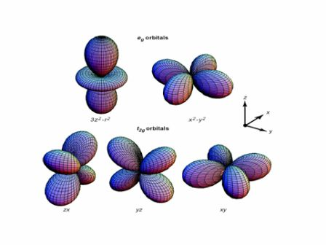
Real d orbitals in Octahedral coordination
eg’s have lobes pointing to anion forming
sigma bonds and the t2g’s have lobes
pointing between the anions with pi bonds

Slide 41
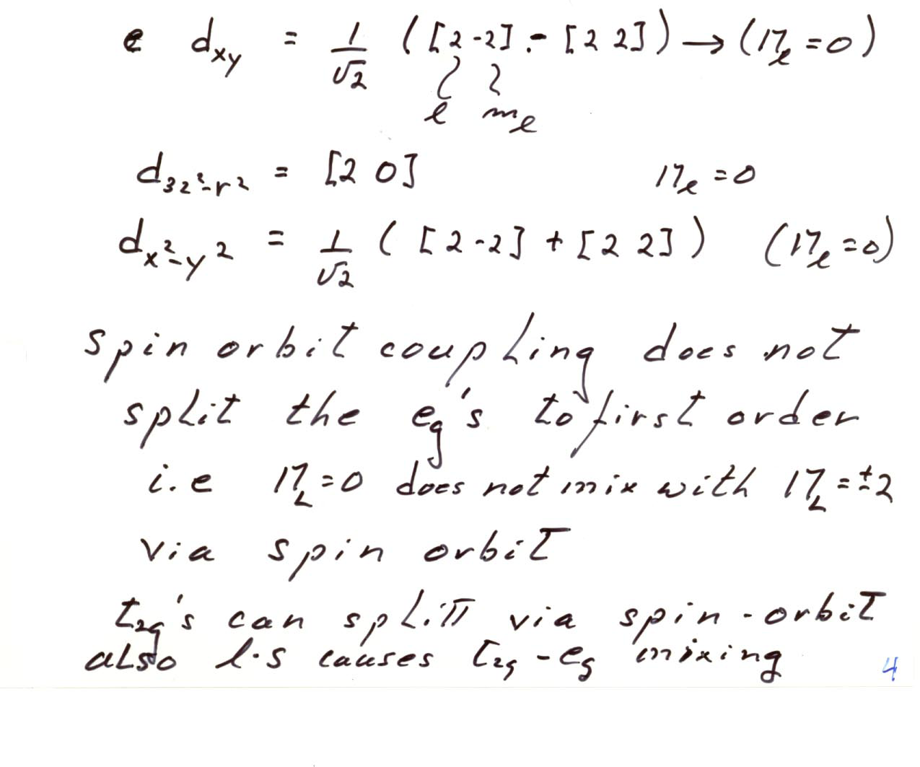
Two kinds of d orbitals generally used
All have 0 z
component
Of angular
momentum
In cubic symmetry the two eg’s and 3 t2gs are 2 and 3 fold degenerate respectively.
The spin orbit coupling does not mix the eg orbitals to first order but it does mix the t2g’s
which then get split into a doublet and a singlet in cubic symmetry

Slide 42
Crystal and ligand field splitting
Many of the interesting transition metal compounds are quite ionic
in nature consisting of negative anions like O (formally2-) and positive
TM ions. Part of the cohesive energy is due to Madelung potentials
produced by such an ionic lattice. Recall that O2- is closed shell with
6 2p electrons quite strongly bound to the O .
Expanding the potential produced by surrounding ions close to a central
TM ion produced a different potential for the eg and t2g orbitals
resulting in an energy splitting. The point charge contribution is:
The resulting energy shift of the d orbitals is;
In first order perturbation theory and the di are the eg and t2g wave
functions defined above. Only terms with m=0,4 and n=4 will contribute
In cubic symmetry this splits the eg and t2g states by typically 0.5 to 1 eV with in
Octahedral coordination the t2g energy lower than the eg energy

Slide 43
There is another larger contribution from covalency or the virtual
hoping between the O 2p orbitals and the TM d orbitals. Since the
eg orbitals are directed to O these hoping integrals will be larger than
those for the t2g orbitals
eg
t2g
TM 3d
Δ
O2p
Often about 1-2eV In Oxides
Density functional band theory provides good reliable values for
the total crystal and Ligand field splitting even though the band
structure may be incorrect.

Slide 44
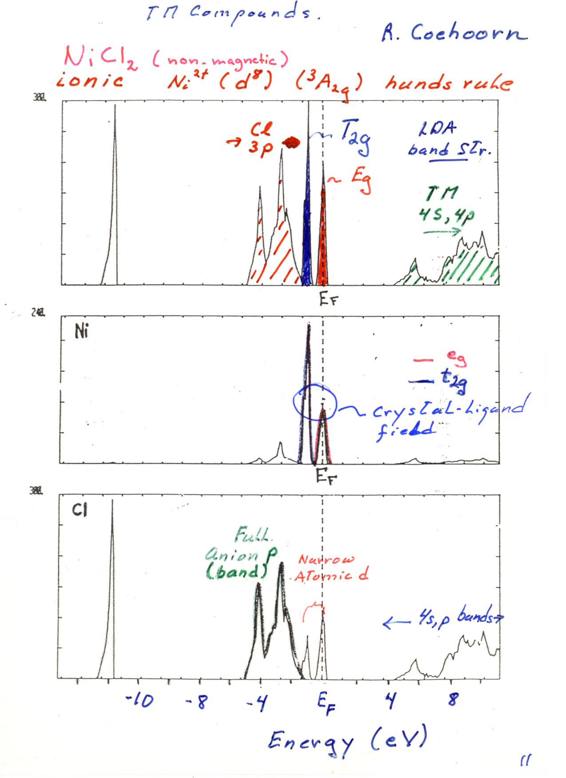
Note the rather broad Cl 2p bands
And the very narrow Ni 3d bands
Split into eg and t2g . Note also the
Crystal field spliting of about 1.5eV.
Note also that DFT (LDA) predicts
a metal for NiCl2 while it is a pale
yellow magnetic insulator.
Note also the large gap between
Cl 2p band and the Ni 4s,4p bands
With the 3d’s in the gap. This is a
typical case for TM compounds

Slide 45
Two new complications
d(n) multiplets determined by Slater atomic integrals or Racah parameters A,B,C for d electrons. These determine Hund’s rules and magnetic moments
d-O(2p) hybridization ( d-p hoping int.) and the O(2p)-O(2p) hoping ( O 2p band width) determine crystal field splitting, superexchange , super transferred hyperfine fields etc.

Slide 46
The d-d coulomb interaction terms contain density -density like integrals,
spin dependent exchange integrals and off diagonal coulomb integrals i.e.
Where n,n’ m,m’ are all different. The monopole like coulomb integrals
determine the average coulomb interaction between d electrons and basically
are what we often call the Hubbard U. This monopole integral is strongly reduced
In polarizable surroundings as we discussed above. Other integrals contribute to
the multiplet structure dependent on exactly which orbitals and spin states are
occupied. There are three relevant coulomb integrals called the Slater integrals;
= monopole integral
= dipole like integral
= quadrupole integral
For TM compounds one often uses Racah Parameters A,B,C with ;
Where in another convention ;
The B and C Racah parameters are close to the free ion values and can be carried over
From tabulated gas phase spectroscopy data. “ Moores tables” They are hardly reduced in
A polarizable medium since they do not involve changing the number of electrons on an ion.

Slide 47
Reduction of coulomb and exchange in solids
Recall that U or F0 is strongly reduced in the solid. This is the monopole coulomb integral describing the reduction of interaction of two charges on the same atom
However the other integrals F2 andF4 and G’s do not involve changes of charge but simply changes of the orbital occupations of the electrons so these are not or hardly reduced in solids . The surroundings does not care much if locally the spin is 1 or zero.
This makes the multiplet structure all the more important!!!!! It can in fact exceed U itself

Slide 48
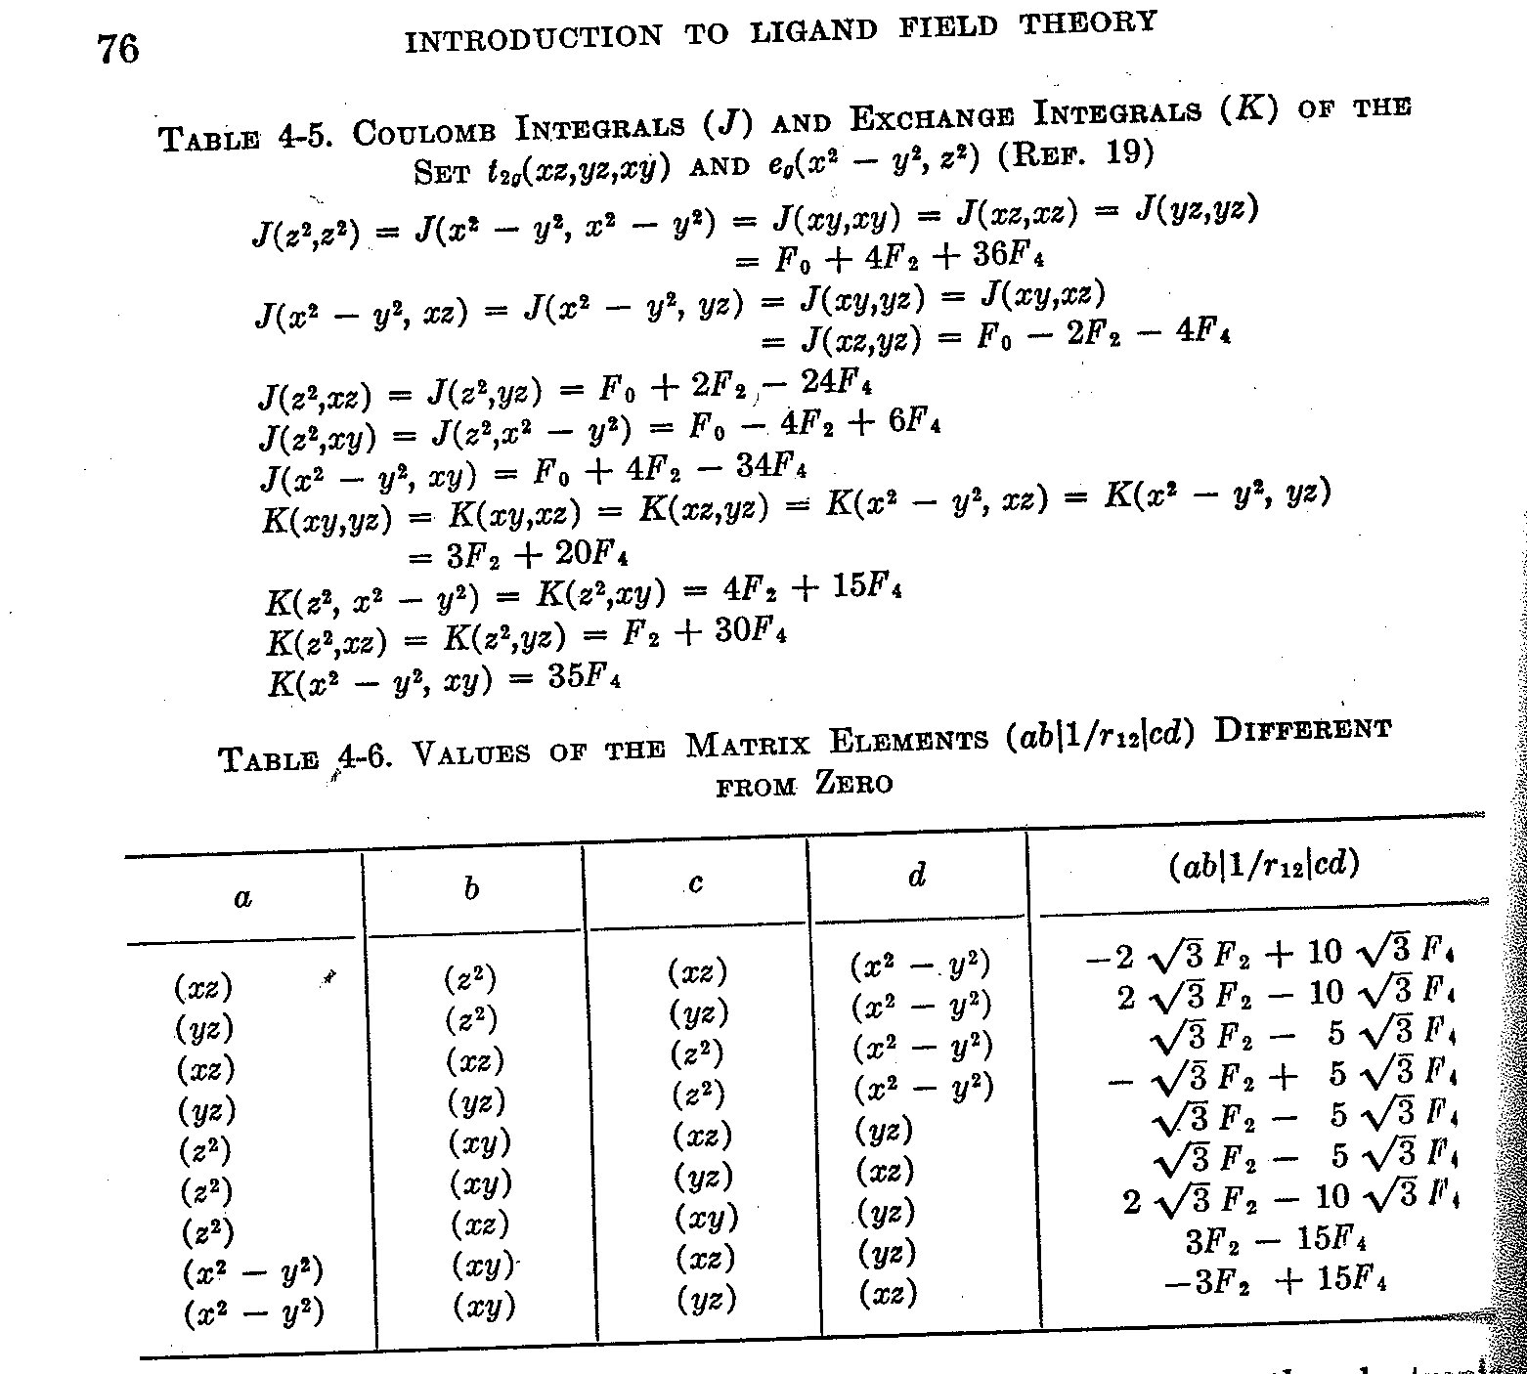
Ballhausen

Slide 49
Multiplet structure for free TM atoms rare
Earths can be found in the reference
VanderMarel etal PRB 37 , 10674 (1988)

Slide 50
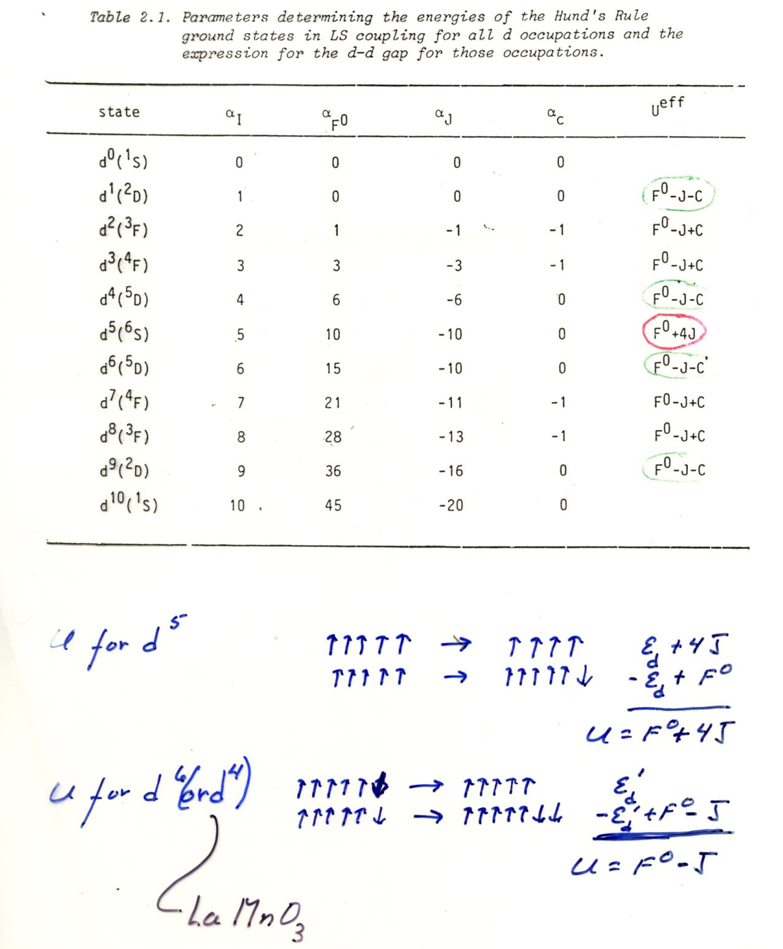
VanderMarel etal PRB 37 , 10674 (1988)

Slide 51
Hunds’ rules
First the Physics
Maximize the total spin—spin parallel electrons must be in different spatial orbitals i.e. m values (Pauli) which reduces the Coulomb repulsion
2nd Rule then maximize the total orbital angular momentum L. This involves large m quantum numbers and lots of angular lobes and therefore electrons can avoid each other and lower Coulomb repulsion

Slide 52
Hunds’ third rule
< half filled shell J=L-S > half filled shell J=L+S
Result of spin orbit coupling
Spin orbit results in magnetic anisotropy, g factors different from 2, orbital contribution to the magnetic moment, ---

Slide 53
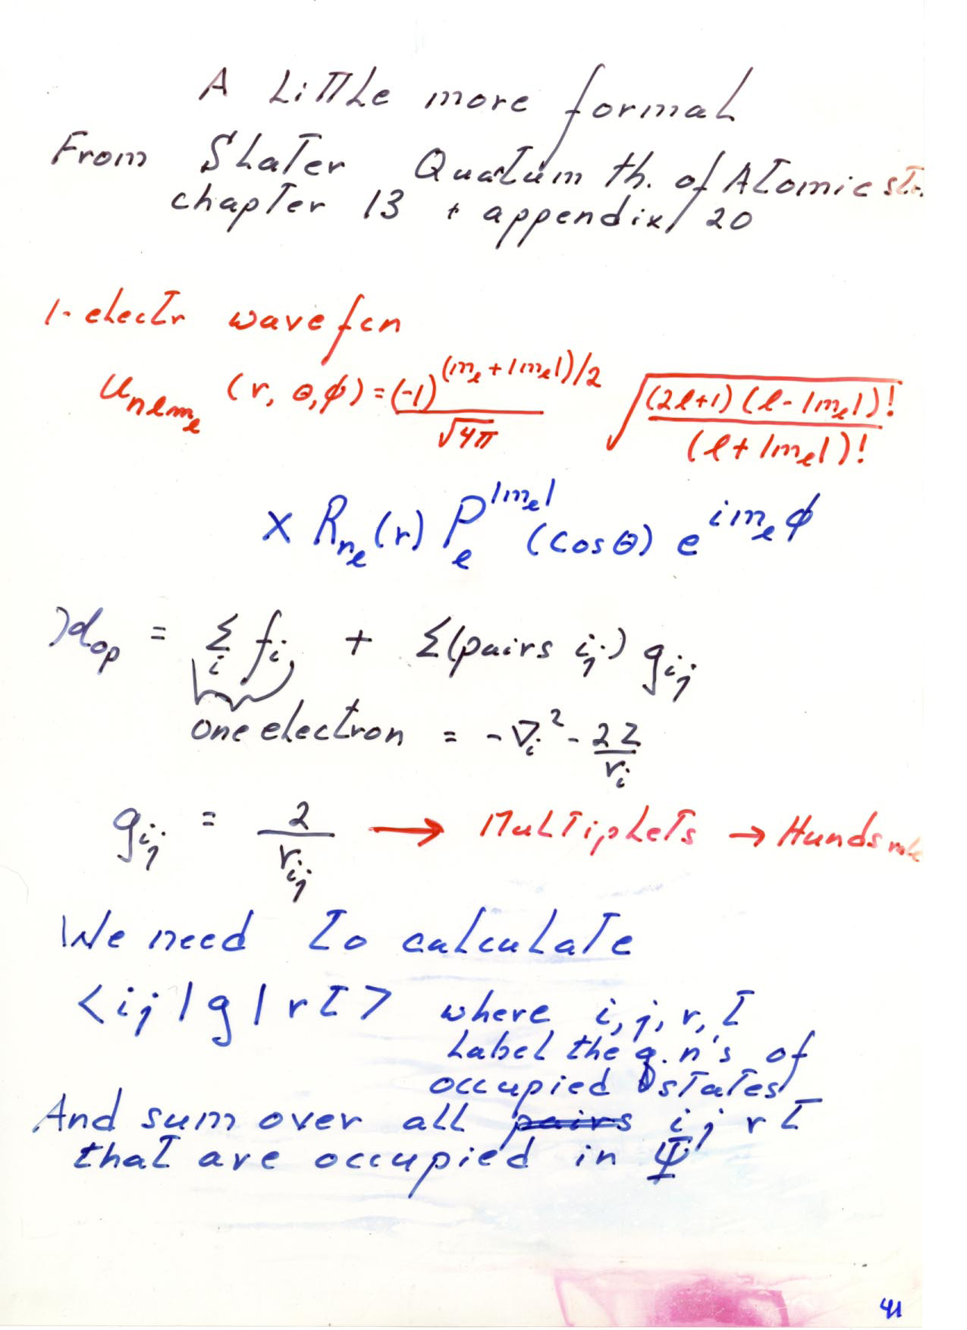
A little more formal from Slater “ Quantum theory of Atomic structure chapter 13 and appendix 20
One electron wave function
We need to calculate
Where I,j,r,t label the quantum Numbers of the occupied states and
we sum over all the occupied states in the total wave function

Slide 54
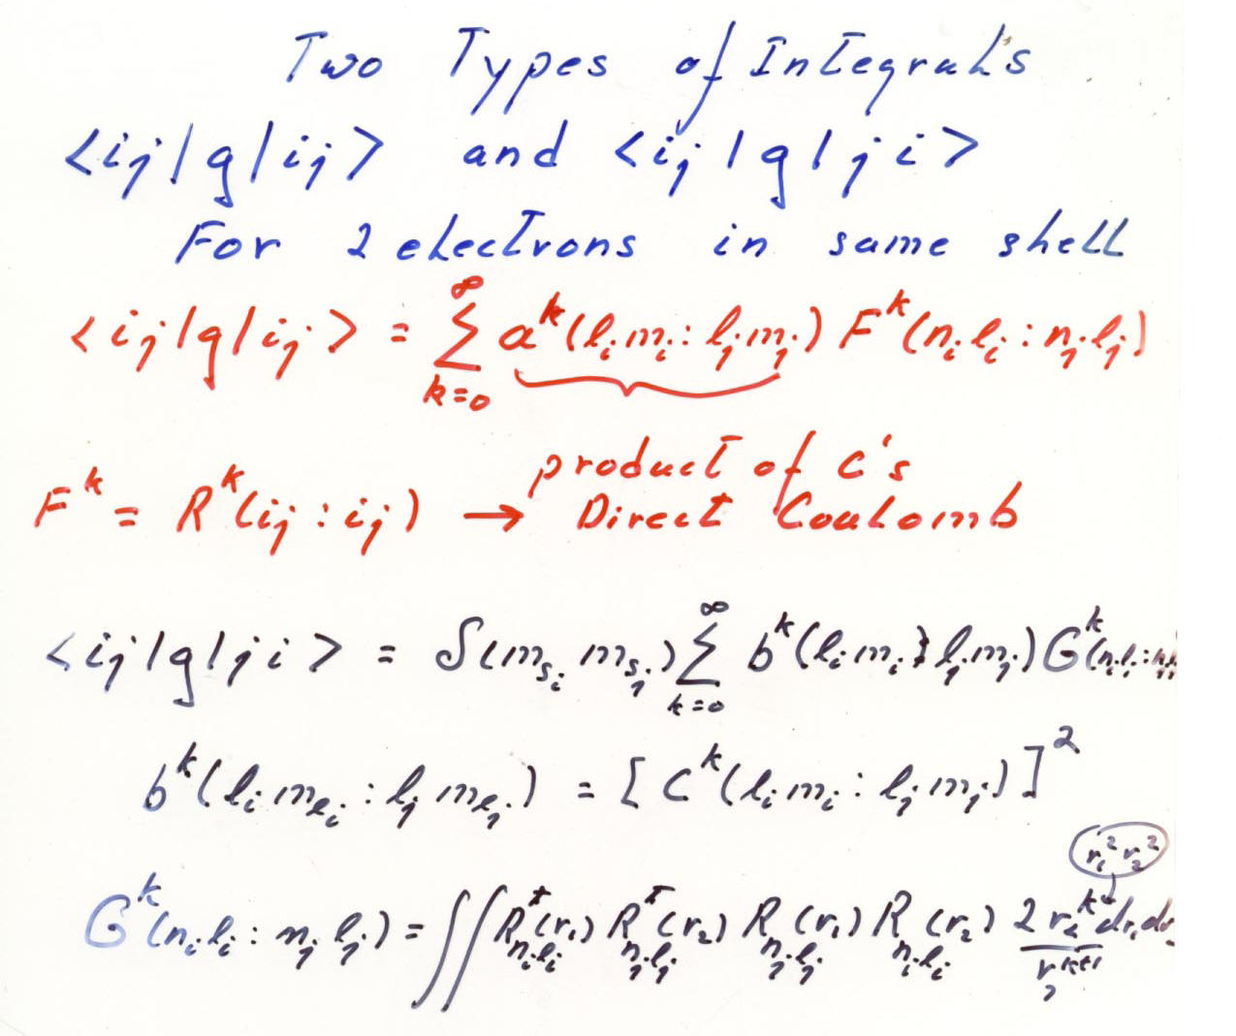

Slide 55
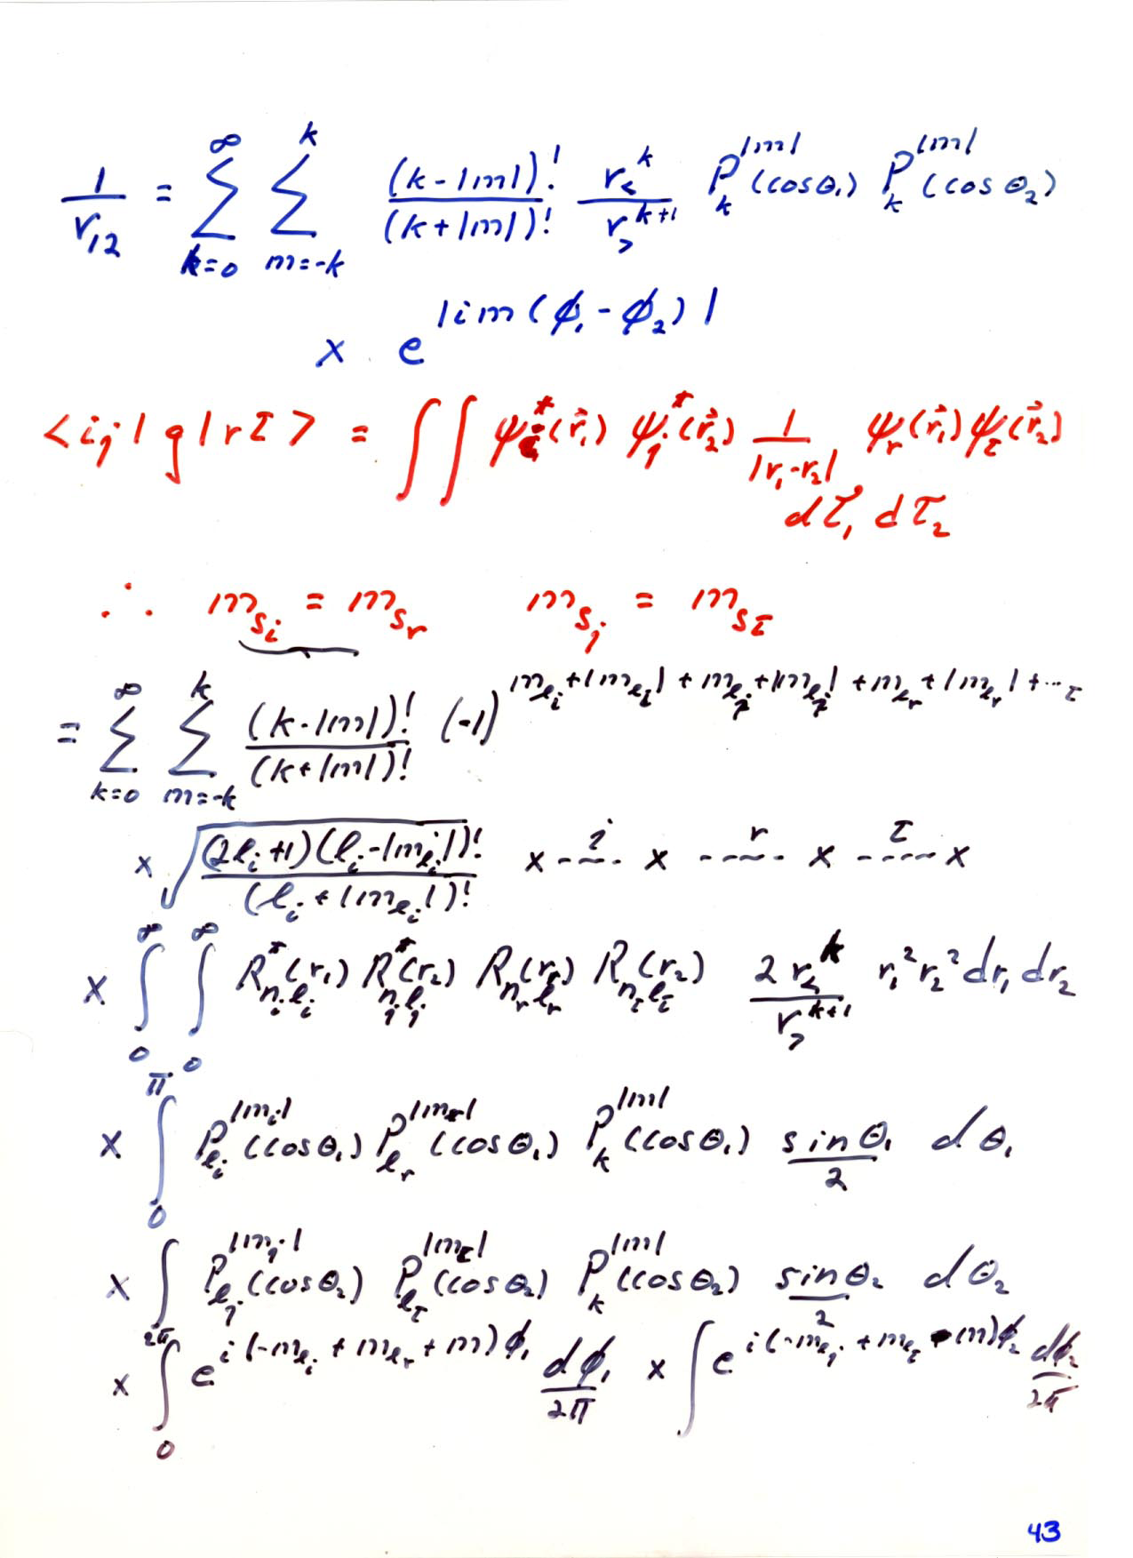

Slide 56
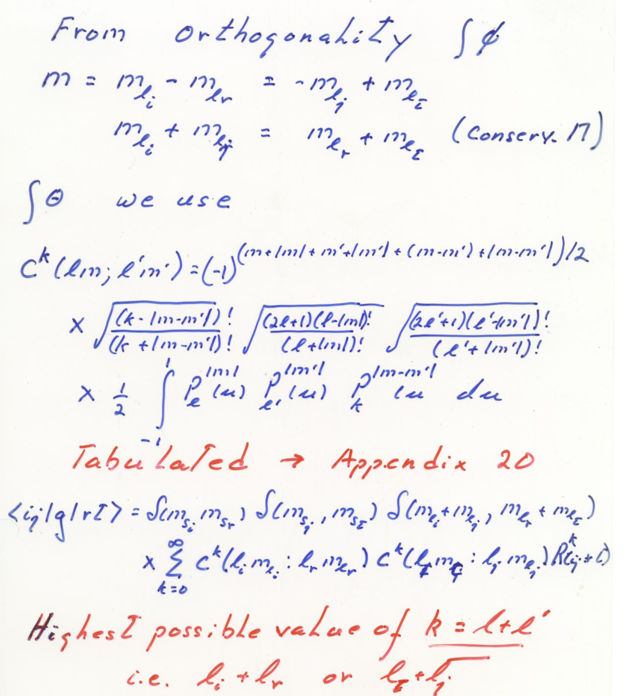

Slide 57
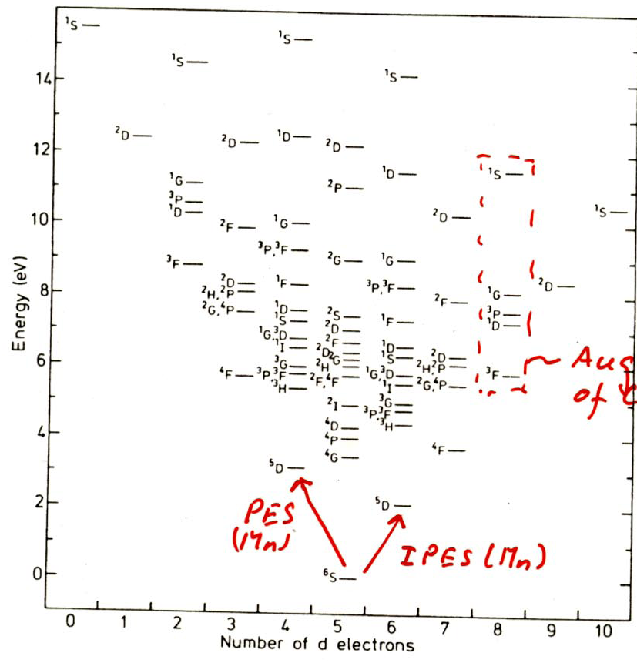
Nultiplet structure of 3d TM free atoms
VanderMarel etal PRB 37 , 10674 (1988)
Note the high energy scale
Note also the lowest energy
state for each case i.e. Hunds’
Rule;

Slide 58
Simplified picture of Crystal fields and multiplets
Determine energy levels assuming only crystal and ligand fields and Hunds’ first rule i.e.
Neglect other contributions like C in our former slides and the SO coupling
This is a good starting point to generate a basic understanding . For more exact treatments use Tanabe-Sugano diagrams

Slide 59
Crystal fields, multiplets, and Hunds rule for cubic (octahedral) point group
Free ion
Cubic Oh
eg
(4)J is the energy to flip
One of spins around
10DQ= crystal field
10DQ
t2g
d5; Mn2+, Fe3+
4J
eg
S=5/2
No degeneracy
t2g
t2g
d4; Mn3+, Cr2+
3J
eg
S=2 two fold
degenerate
t2g

Slide 60
eg
S=2; 3 fold
degenerate
10DQ
t2g
d6; Fe2+, Co3+
3J
eg
t2g
d2; Ti2+, V3+
J
S=1; 3 fold
degenerate

Slide 61
Physical picture for high spin to low spin transition
eg
10DQ
E(HS)=-10J-4DQ
E(LS)= -6J-24DQ
HS to LS for 10DQ>2J
t2g
d6; Fe2+, Co3+
3J
eg
t2g
eg
10DQ
t2g
E(HS)=-10J
E(LS)=-4J-20DQ
HS to LS for 10DQ>3J
d5; Fe3+, Co4+
4J
eg
0J
t2g

Slide 62
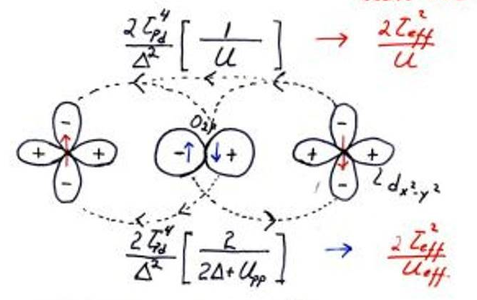
Goodenough Kanamori Anderson rules
i.e. interatomic superexchange interactions
And magnetic structure
For example Cu2+---O----Cu2+ as in La2CuO4 and superconductors
Cu2+ is d9 i.e. 1 eg hole (degenerate in OH) but split in D4H as in a
Strong tetragonal distortion for La2CuO4 structure. The unpaired
electron or hole is in a dx2-y2 orbital with lobes pointing to the 4
Nearest O neighbors.
Anderson 1961
If the charge transfer energy Δ gets
small we have to Modify the
superexchange theory
New term
The sum leads to a huge antiferro
Interatomic J(sup) =140meV
for the Cuprates

Slide 63
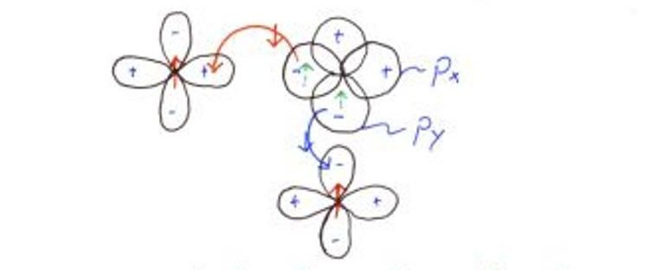
Superexchange for a 90 degree bond angle
The hoping as in the fig leaves two holes in the intervening
O 2p states i.e. a p4 configuration. The lowest energy state
According to Hund’s rule is Spin 1. So this process favours
A ferromagnetic coupling between the Cu spins.
So the net exchange as a function of the
bond angle is:

Slide 64
Superexchange between singly occupied t2g orbitals
dxz
dxz
z
pz
x
If we now rotate one of the bonds around the z axis the superexchange does not change , but for rotation around the y axis it changes as for eg orbitals. Since

Slide 65
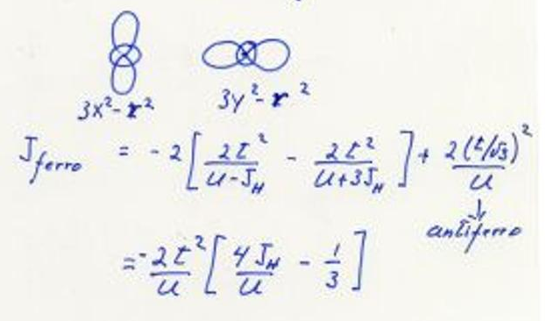
If we have “spectator spins “ as in Mn3+ in OH
d4; Mn3+, Cr2+
For ferro orbital ordering we will get
a strong antiferromagnetic super
exchange since the same intervening
O 2p orbital is used in intermediate
States as in the example above
t2g
3J
eg
t2g
For antiferro orbital ordering
The factor of 3 in the Hunds’
Rule of Mn is from the “spectator”
spins

Slide 66
For example in LaMnO3 and the “Colossal” magneto resistance materials La(1-x)CaxMnO3 and now with “orbital ordering “ the extra eg spin has a strong anti- ferro superexchange coupling for ferro orbital ordering i.e. as in the example above for 180 degree bond. But the superexchange is weakly ferromagnetic for antiferro orbital ordering since then both ferro and antiferro terms compete differing only by the Hunds’ rule which now also involves the “spectator “ spins in t2g orbitals. We have neglect the superexchange involving the t2g orbitals here.

Slide 67
Zener Double exchange
This is important in for example in La(1-x)CaxMnO3 which are colossal magneto resistance materials. Here the extra eg electron pictured in former slides is free to move even if U is large because of the mixed valent nature of the Mn. Some of the Mn3+ (d4) is now Mn3+(d3) which has empty eg orbitals. However the eg electron can only move freely if the spectator t2g spins are ferromagnetically aligned yield a large band width and so a lowering of the kinetic energy. The ferromagnetic exchange is proportional to the one electron band width

Slide 68
Orbital degeneracy
If there is orbital degeneracy the Jahn Teller theorem tells us that it will be lifted in on way or another at low temperatures. This is because the system can always lower its energy by lifting this degeneracy
We distinguish to types those involving eg or t2g orbitals. We consider cubic and OH symmetry to start with
Strong Jahn teller ions
Weak Jahn Teller ions
Strong for strong eg hybridization with ligand and weak for weak t2g hybridization with ligands

Slide 69
How can we lift the degeneracy
Spin orbit coupling if we have t2g degeneracy. Recall the eg’s do not split with SO.
Jahn Teller distortion i.e. from Cubic to tetragonal would split the eg orbitals into d(3z2-r2) and d(x2-y2) (Examples are cuprates
Orbital ordering which may be driven by other than electron phonon coupling
Charge disproportionation i.e.
Where both final configurations are not orbitally degenerate. We will see later why this could happen inspite of a large U

Slide 70
Lattice distortions i.e. the Jahn Teller effect
Operates via electron phonon coupling with asymmetric phonon modes which locally distort the lattice.
For z axis long the doublet would be lowest This lifts the orbital degeneracy for this case
Tetragonal
Z axis shorter
Free ion
Cubic Oh
eg
t2g
3J
d(3z2-r2)
eg
d(x2-y2)
dxz,dyz
t2g
dxy

Slide 71
Orbital ordering
Consider again the case of Mn3+ with the doubly orbital degenerate eg level in cubic symmetry occupied by only one electron as above.
It would be logical in a perovskite structure that long bond axis would alternate say along x and y for two Mn ions sandwiching an O anion as in the next slide

Slide 72
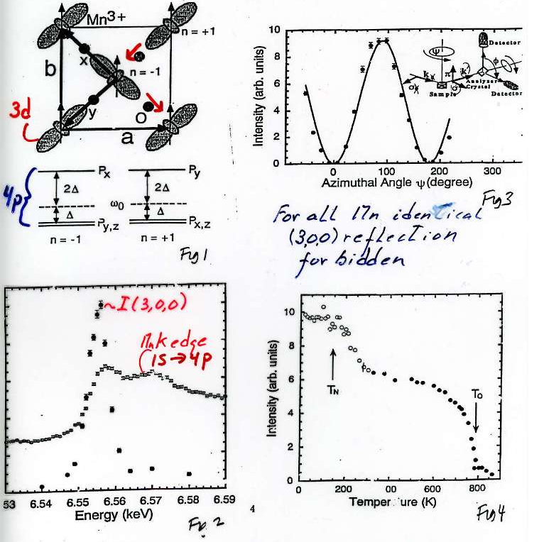
For LaMnO3 resonant x ray diffractions yields the orbital occupation structure below with Alternating occupied eg orbitals rotated by 90 degrees as see in the basal plain. The small red arrows indicate the Oxygen displacement resulting from this leading to a so called cooperative Jahn Teller distortion
Murakami et al
The 300 reflection
Is generally forbidden
but visible at resonance
Because of the orbital
ordering
See two transitions. One at high Temp for the orbital ordering and one at low T for antiferromagnetic order. The spin ordering in plane is ferromagentic as we would have predicted

Slide 73
Hamiltonian for orbital and spin order (Kugel Khomskii 1982)
The first term describes spin structure and magnon excitations
Second term the Orbital order and Orbiton or d-d exciton excitation
Third term is the strong interaction between Orbitons and spin waves
this interaction can lead to new bound or spin polaronic like states.
In addition we really should have included the electron phonon interaction
which would result in lattice distortions depending on the orbital order
and in lattice polaronic like effects coupling with orbitons and magnons.
Since all these interactions are of the same order of magnitude the
situation is very complicated but also very rich in new physical
properties and phenomena

Slide 74
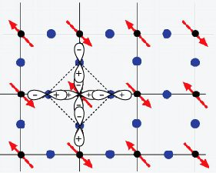
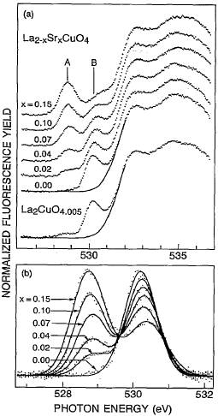
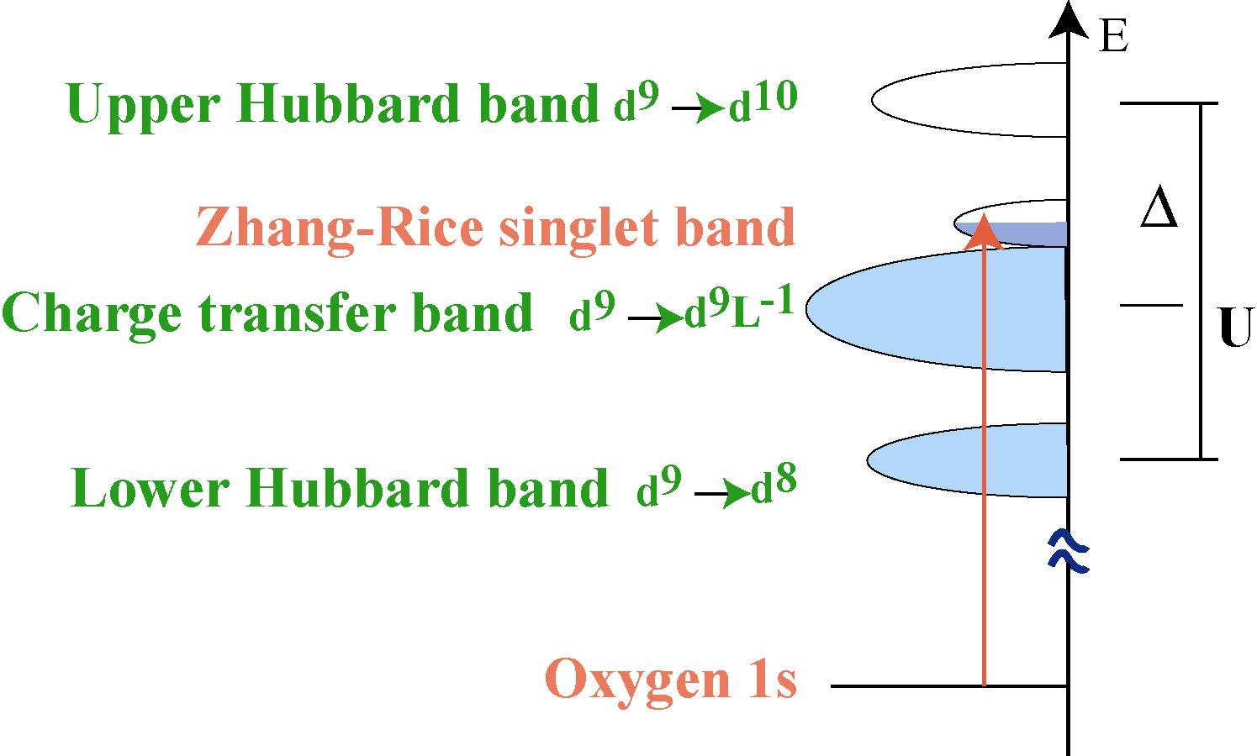
Doped holes in cuprate
As we hole dope the system the O1s to 2p first peak rises very strongly indicating
That the doped holes are mainly on O 2p.
C. T. Chen et al. PRL 66, 104 (1991)

Slide 75
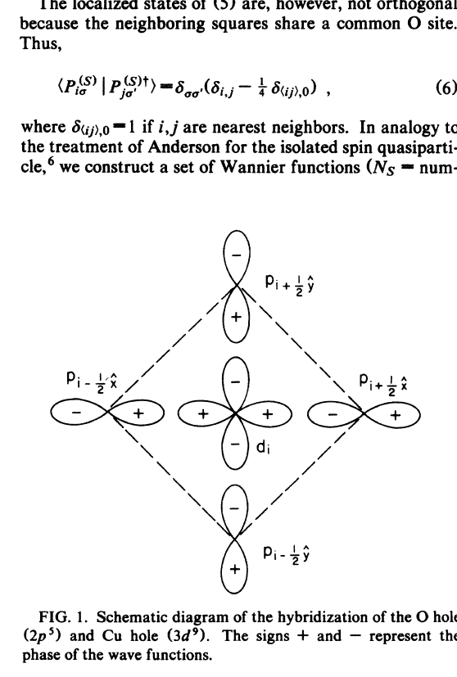
Is single band Hubbard justified for Cuprates?
Zhang Rice PRB 1988
37,3759

Slide 76
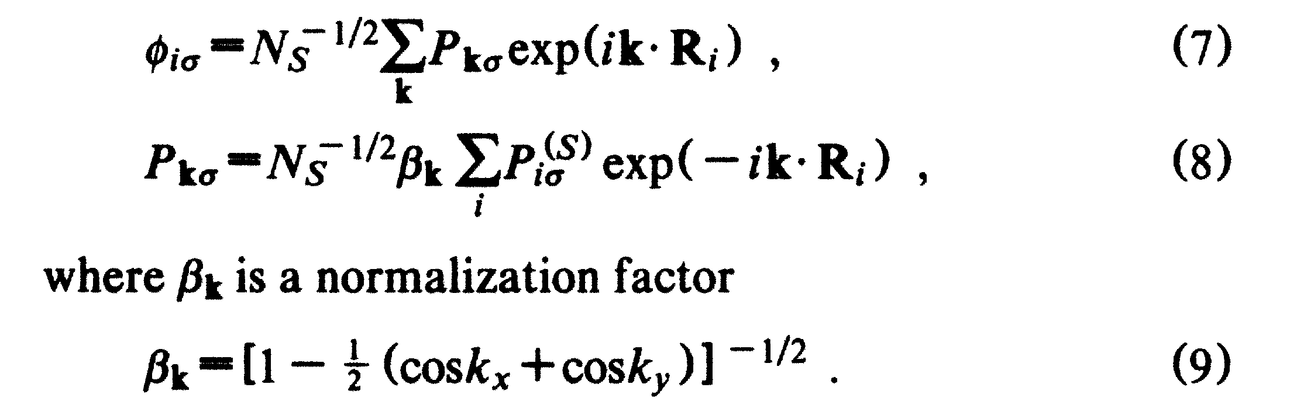
Problem with ZR singlets
The combination of O 2p states is not compatible with a band structure state
The wave functions are not orthogonal
From ZR PRL 37,3759
Note it goes to infinity at k=0, should we see it at Gamma in ARPES?
Luckily i goes to 1 for K= Pi/2,Pi/2 and anywhere along the AF zone
boundary where the FIRST doped holes go
In band theory O 2p does not mix with Cu dx**2-y**2 at Gamma!!!!! SO HOW TO DO
THIS PROPERLY FOR HIGH DOPING?

Slide 77
Is this only a problem for the Cuprates?
What about the Nickalates, Manganites, Cobaltates etc?

Slide 78
Kuiper et al PRL 62 221 (1989) LixNi1-x O
A CHARGE TRANSFER GAP SYSTEM HOLES IN O
Note the high “pre-
Edge feature and the
Spectral weight
Transfer from high
To low energy scales
Just as in the cuprates
The holes are mainly on
O and not on Ni.!!

Slide 79
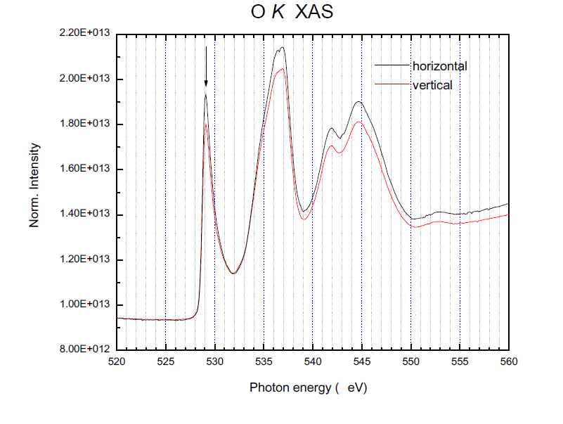
LNO thin film on LSAT Sutarto, Wadati, Stemmer UCSB
Note the huge O 1s -2p prepeak just as in the cuprates HOLES ON O

Slide 80
Can we renormalize and get rid of the anion states?
Similar to the Zhang Rice singlets in the cuprates?

Slide 81
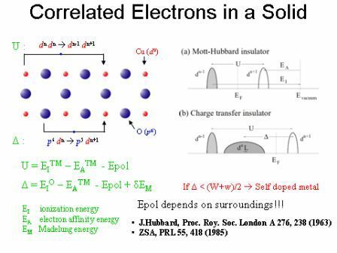
Oxides are more complicated
Remember at surfaces U is increased, Madelung is decreased, W is decreased

Slide 82
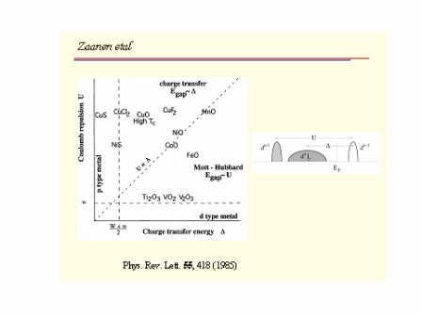
For divalent cations

Slide 83
High oxidation states
In general we expect the charge transfer energy to strongly decrease for higher oxidation states
This would mean a different starting point i.e.
Cu3+ Cu2+L Ni3+ Ni3+L Co4+ Co3+L
Fe4+ Fe3+L Mn4+???
The charge degrees of freedom are on Oxygen

Slide 84
Charge disproportionation without moving charge
Consider ReNiO3 Ni3+ on average but label it as Ni2+L
Then each Ni is surrounded by 2 L holes in ReNiO3
( 1 hole per 3 O) 2Ni3++
Ni2+ + Ni4+
Two holes in O2p
Orbital in octahedron
With central eg symmetry
Ni2+ no JT
Each second Ni2+ has an octahedron of O with two holes
of Eg symmetry in bonding orbital's I.e. d8 L2
No Jahn Teller problem anymore

Slide 85
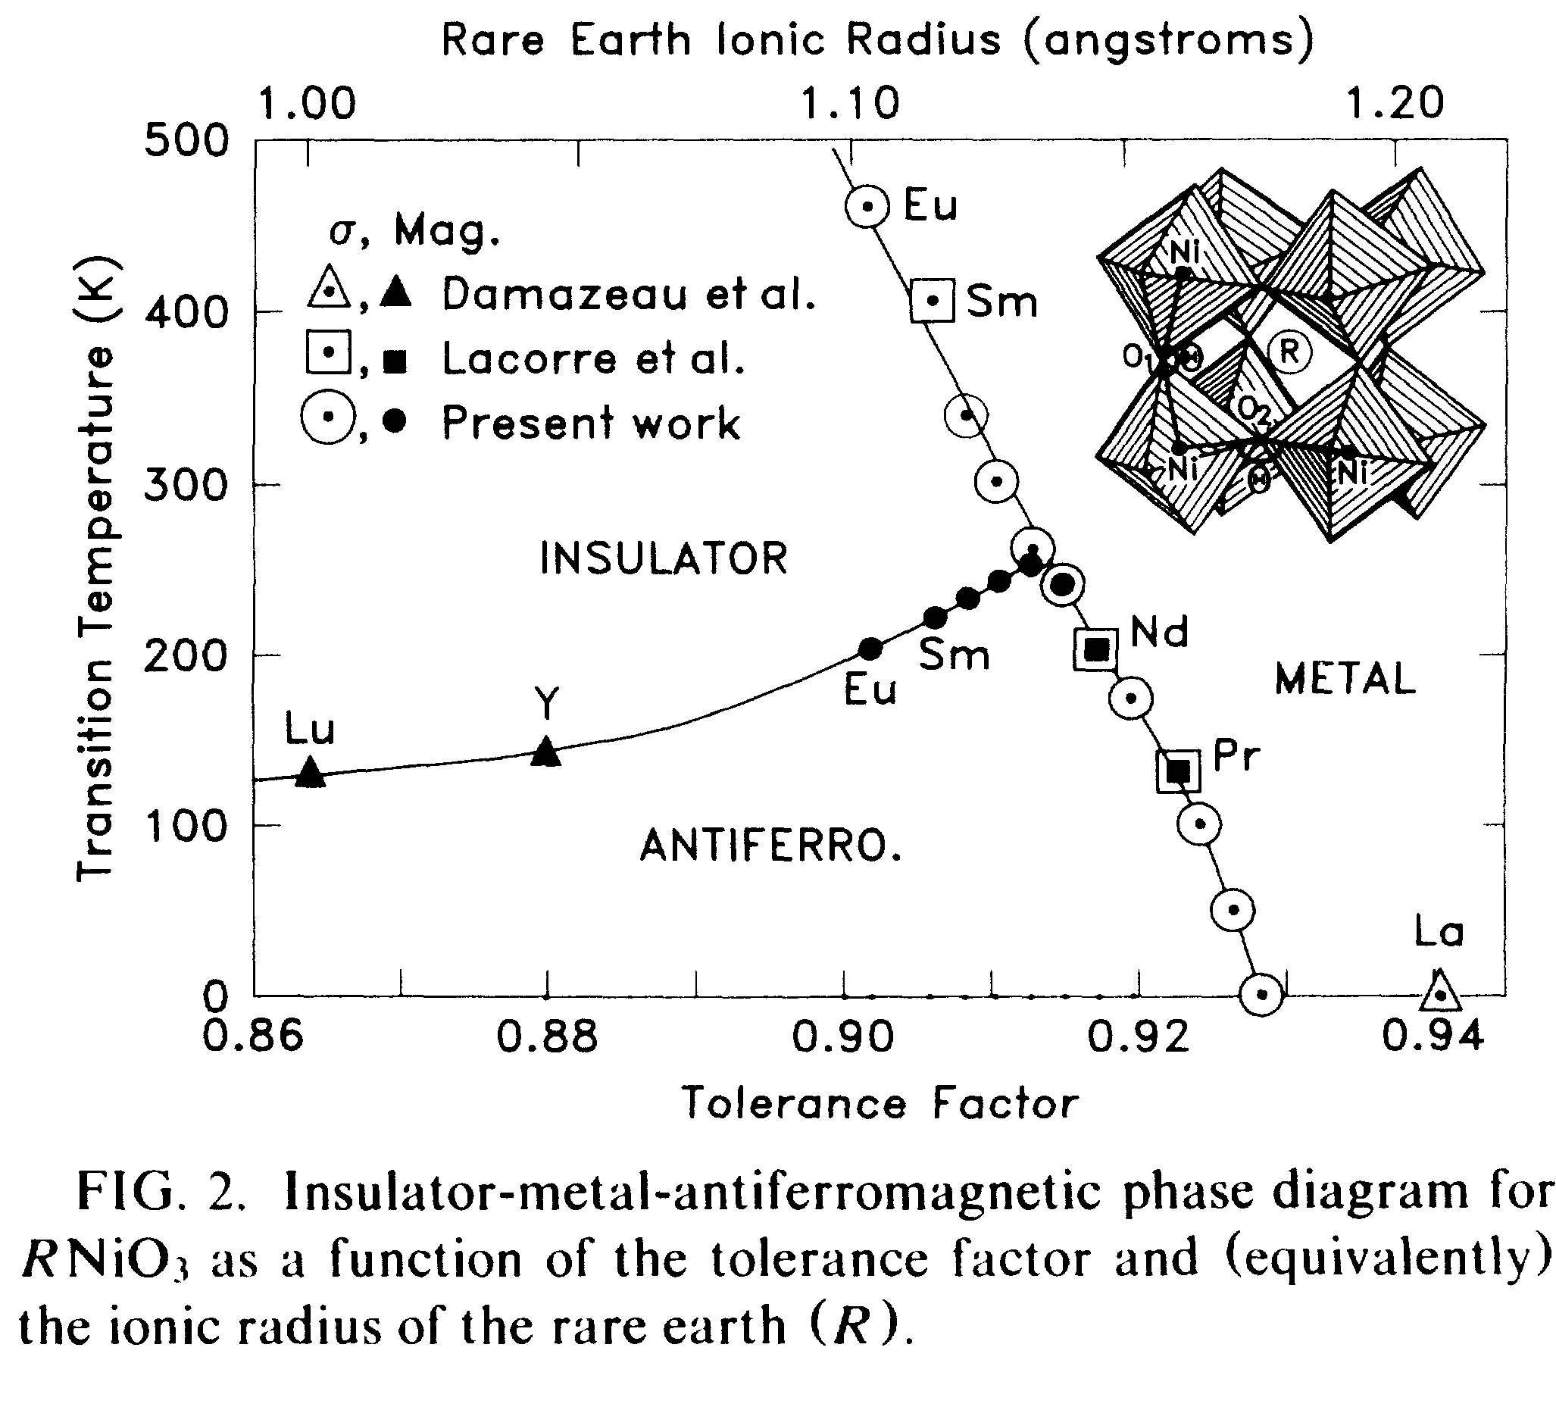
Torrance et al PRB 42, 8209

Slide 86
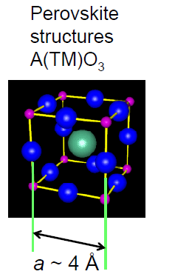
The nickaltes i.e. RENiO3
Lets associate the two holes (with S=1)
with one Ni which will then be a S=0
cluster Because of Jpd. The octahedron
will contract leaving the other Ni
neighbors in a d8 S=1 state. This gives the
correct structure at low T and in fact also
gives the correct spin structure .
Effective disproportionation without
moving charge.
THIS STATE SEEMS TO BE NEARLY
DEGNERATE WITH A METALLIC ITINERANT
O HOLE STATE

Slide 87
What do we mean by the conductivity gap in a material
The minimum energy cost to remove an electron minus
the maximum energy gain to add one to the ground state
E gap = E0 (N-1) +E0(N+1) – 2E0(N)
N is the number of electrons in
The ground state. E0 here stands
For the lowest energy state in each case.

Slide 88
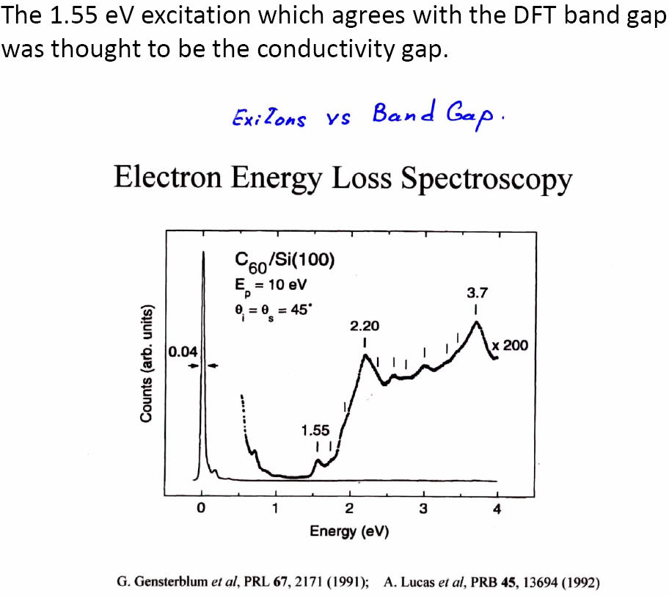

Slide 89

C60

Slide 90


Slide 91
Electronic Structure of oxide surfaces and interfaces
A path to new materials and devices?

Slide 92
Summary
Surface electronic structure of Oxides
Reconstruction at Polar surfaces and interfaces; electronic, ionic, chemical
There still is a lot of uncertainty/controversy concerning the electronic structure changes at oxide surfaces and interfaces. We need improved materials and improved methods to study buried interfaces.

Slide 93


Slide 94


Slide 95


Slide 96
New quantum materials
Based on Oxides
Interplay charge, spin, orbital and lattice
Interface control : strain- pressure, internal electric fields, local symmetry changes which change crystal fields and superexchange interactions

Slide 97


Correlated Electrons in transition metal compounds
U :
d^{n} d^{n} → d^{n-1} d^{n+1}
Cu (d⁹)
O (p⁶)
Δ :
p⁶ d^{n} → p⁵ d^{n+1}
U = E_{I}TM – E_{A}TM - Epol
Δ = E_{I}^{O} – E_{A}TM - Epol + δE_{M}
If Δ < (W+w)/2 → Self doped metal
E_{I} ionization energy
E_{A} electron affinity energy
E_{M} Madelung energy
Epol depends on surroundings!!!
J.Hubbard, Proc. Roy. Soc. London A 276, 238 (1963)
ZSA, PRL 55, 418 (1985)
At a surface the charge transfer energy decreases ,
And U also increases and the band widths also decrease

Slide 98

Novel Nanoscale Phenomena in Transition-Metal Oxides
Ionic Oxide Polar Surfaces
Correlated Electron System Surfaces
Stabilization of polar surfaces by epitaxy
Kinks and steps stabilized by epitaxy
Sr
O
Sr
O
Sr
O
NiO (100) 1D Metallic steps
Superconducting Copper oxides
Applications: Novel SC; QuBits
< 10 ML
Strained 2D Layers
Positive and negative pressure
+1
-2
+2
-2
+2
-1
LaMnO₃
Mn³⁺ 3d ⁴
Transparent insulator ½ metallic FM
Applications: Spintronics; CMR
e_{g}
t_{2g}
Electronic Structure of Interfaces
Metal-Insulator interface: gap suppression
Applications: CMR; M-I Transition; Orbital Ordering
Artificial Molecules Embedded into a Material
Ca, Mg, Sr, Ni vacancies or O-N substitution in oxides
O
J
N
Applications: Molecular Electronics;
Fuel Cells; Thermal Barrier Coatings
New class of magnetic materials by ‘‘low-T’’ MBE growth
Applications: Spintronics; Novel Magnets

Slide 99
Surface Madelung potential
Divide the solid into two halves plus a single layer in between . The single layer plus one of the two halves would form a half infinite solid with the single layer as the surface.
An ion marked X in the single layer would feel a MP due to the half infinite plus that produced by the single layer.
The bulk MP at the same ion X would be twice that of the half infinite solid plus that from the single layer.
MP(bulk)=MP(left half)+MP (right half)+MP(single layer)= 2MP(half infinite)+MP(single Layer)
MP(half infinite)=1/2 MP(Bulk) –MP(single layer)
MP(surface)=MP(half infinite)+ MP(single layer)
=1/2(MP(bulk)+MP(single layer))
X

Slide 100

Madelung potentials for rock salt structure TM monoxides
Two extreme cases are considered ,fully ionic i.e. 2+ and 2- charges and 1+,1- charges

Slide 101
Madelung potential depends on coordination number
Drawn is a 110 surface where TM has 2 missing O2-
Neighbors.
The front face is 100 and in it each TM ha one O2-
nearest neighbor missing
Basically this describes the systematics of the surface
Madelung potential
Remember that for the charge transfer gap materials the band gaps are determined by the charge transfer energy which changes by twice the change in the Madelung potential or by 2.6 eV for the monovalent case and twice this for the divalent case

Slide 102

Metallic states for negative charge transfer gap energies as could happen at step edges.

Slide 103
The theory of systems with negative charge transfer gap energies
This is really complicated since we now cannot use our simple non metallic ansatz. We then have a problem of a high density of local spins in dn states with strong hybridization and exchange with the holes on O.
The case I alluded to of LaNiO3 is perhaps such an example.
We might be able make interesting new materials using vicinal or Stepped surfaces to generate negative chanrge transfer gaps.

Slide 104

Systemtics of conductivity gaps gaps

Slide 105
Neutral (110) surfaces of NiO
Slab of 7 NiO layers
LSDA+U: U=8eV J=0.9eV
Band gap at surface decreases from 3 eV to 1.2 eV
Step edges could be 1D strongly correlated metals
Note the splitting of the eg unoccupied bands due
To the symmetry lowering at the surface

Slide 106




SrTiO3 (001) surface
TiO2 terminated surface PDOS
O 2p
Ef
y
Ti 3d
Ef
x
Ti
TiO2 surface
The degeneracy of states at the surface is lifted due to reduced symmetry.
Surface band gap is reduced by 0.8eV from 1.9eV in the bulk.
Reduction of Madelung potential and hybridization at the surface of ionic material.

Slide 107
What happens for surfaces with a net charge and a +,-,+,- alternation of layers?
These are so called polar surfaces and they have an infinite energy and cannot exist as the termination of a bulk materials.
SO WHAT HAPPENS?
These are the examples that yield a metallic and also superconducting interface between two insulating materials of which one is polar.

Slide 109

POLAR SURFACES
The basic physics involved in the new
discoveries of Spectacular properties
of some oxide interfaces?
LaAlO3/SrTiO3
Interface of two
insulators =
superconductor
Hwang, Mannhart, Trisconne,
Blanck, -------

Slide 110



Classification of Ionic Crystals Surfaces
Type 1 : all planes are charge neutral
SrO
0
(001) surface of tetravalent perovskites SrTiO3 ...
TiO2
0
SrO
0
TiS2
LiFeAs
Type 2 : planes are
charged but there
is no dipole in repeat unit
-2
+1/2
+4
-3/2
-2
+2
-2
+4
-3/2
-2
+1/2
(001) surface of trivalent perovskites
LaAlO3, LaMnO3 ...
Type 3 : planes are charged
and there is dipole in repeat unit
LaO
+1
AlO2
-1
P.W. Tasker, J. Phys. C 12, 4977 (1979)
LaO
+1
Thanks to Ilya Elfimov

Slide 111

What happesn if we have a polar surface?
Take the NaCl Rock salt structure as in NiO, CaO, MgO, MnO etc
Alternating layers of +2 ,-2 charges in the ionic limit.

Slide 112
LSDA Band Structure of CaO (111) Slab terminated with Ca and O
10
10
Spin Up
Ca 4s
Spin Down
5
5
Energy (eV)
0
0
-5
-5
O 2p
-10
-10
Γ
K
M
Γ
A
L
H
A
Γ
K
M
Γ
A
L
H
A
12
But surface is metallic! And ferromagnetic!half metallic ferromagnet
Note:
Bulk material
(no surface)
is an insulator
10
8
Energy (eV)
6
4
2
0
-2
-4
L
Γ
X
W
L
K
Γ

Slide 113
Why are polar surfaces i.e. type 3 different?
Asymmetric boundary condition: Diverging potential
Polar
E = 0
(111)
+Q
x
Q+
E = σ/ε0
-Q
x
Q-
E = 0
+Q
x
Q+
E = σ/ε0
d
-Q
x
Q-
E = 0
0
V
ε0
σd
ε0
2σd
Remember Gauss’s Law?
The field outside an infinite charged plane of
small thickness is given by

Slide 114
Simple explanation : big capacitor
z
z
z
+ Q/2
+ Q/2
+ Q/2
+ Q/2
2E
E
E
- Q/2
- Q/2
- Q/2
- Q/2
+ Q/2
+ Q/2
+ Q/2
+ Q/2
- Q/2
- Q/2
=
- Q/2
+
- Q/2
+ Q/2
+ Q/2
+ Q/2
+ Q/2
- Q/2
- Q/2
- Q/2
- Q/2
+ Q/2
+ Q/2
+ Q/2
+ Q/2
- Q/2
- Q/2
- Q/2
- Q/2
2E * N * d
V
E * d
V
E * (2N-1)*d
V
Solution to polar catastrophe problem is to get rid of big capacitor.

Slide 115


Potential difference between two surfaces of the slab
Vacuum
+(Q - q)
-Q
Vdiv
Vbulk
N - number of bilayers
d - distance between planes
A - unit area
+Q
-Q
MgO (111), 6BL
Vslab
+Q
Vdiv
2xVbulk
-Q
surf
surf
+Q
Vbulk
-(Q - q)
Vacuum
 | Vdiv
MgO (111) | 1002eV
LaAlO3 (001) | 418eV
For 18 bilayer thick films the
Potential difference is in eV)
Far above the Zener breakdown
Limit =Egap

Slide 116
Polar surfaces and interfaces
Cannot be compensated by simply moving things across the interface as in intermixing
Cannot be compensated by moving around charges outside of the polar material as for example compensating for LAO at the LAO/STO interface by moving electrons around O vacancies in STO to the interface!
We need to add charge of order 1 per unit cell to the region around the interface and an equal an opposite charge at the surface or other interface. The materials remains charge neutral

Slide 117




Interesting materials in which electronic reconstruction can strongly alter properties and which can be used for interface engineering to develop new devices with exotic properties.
Super Conductors: YBa2Cu3O6+δ
(Cu) 1+
(BaO) 0
(CuO2) 2-
(Y) 3+
(CuO2 ) 2-
Perovskites: LaTMO3 (Ti,V,Mn ...)
(BaO) 0
Spin, charge and orbital ordering
(Cu) 1+
(001) surface in trivalent compounds
LaOFeAs
1+
Simple oxides:
SrO, NiO, MnO ...
1-
(110) surface
1+
(111) surface

Slide 118
Some key papers on polar surfaces and interfaces
R. Lacman, Colloq. Int. C.N.R.S. 152 (1965) 195
D. Wolf, Phys. Rev. Lett. 68 (1992) 3315.
H.-J. Freund and E. Umbach, Eds., Adsorption on Ordered Surfaces of Ionic Solids and Thin Films, Vol. 33 of Springer Series in Surface Science (Springer, Berlin, 1993).
Hesper et al PRB 62, 16046 2000 coined the phrase Electronic Reconstruction for K3C60 surfaces
Ohtomo and H. Y. Hwang Nature 427, 423 (2004)
Insulating Oxide heterostructures

Slide 119

N.Reyren et al Science express 317, 1196 2007
Superconducting interface SrTiO3/LaAlO3

Slide 120
There are several ways to stabilize a polar surface
Oxygen vacancies at the surface (remove O2- i.e. charge or it won’t work!)
Facetting i.e. piramids with 100 faces (again result has to be removing charge!!)
Adsorbed molecules i.e. OH- on outermost Mg surface (again OH- replaces O2- as outer layer)
Terminating monovalent ions
Electronic reconstruction (move charge from one surface to the other)

Slide 121
Types of reconstruction
Electronic
Ionic
Chemical
+Q
+Q/2
+Q
-Q
-Q
-Q
+Q/2
+Q
+Q
+Q
-Q
-Q/2
-Q
-Q
Rearrangement of
electrons
Rearrangement of
Ions faceting plus charging
Vacancies or add Ions
(K+) or OH- adds charge
K₃C₆₀:
R. Hesper et al., Phys. Rev. B
62, 16046 (2000).
NiO(111):
D. Cappus et al., Surf. Sci.
337, 268 (1995).
K-depositon:
M.A. Hossain et al., Nat. Phys.
4, 527 (2008).
NiO(111):
D. Cappus et al., Surf. Sci.
337, 268 (1995).

Slide 122
Electronic Reconstruction
Energetically favourable in ionic systems with small band gaps and in systems with multivalent components ( Ti,V,C60,Ce,Eu ----)

Slide 123
Interfaces involving polar surfaces
Interfaces between polar and non polar srufaces as
In SrTiO3 and LaAlO3 for example can be magnetic
And Metallic . They will be “self doped” perhaps even
superconducting
The best candidates for electronic reconstruction
at surfaces and interfaces is if one component does
not mind changing its valence !
So use systems exhibiting multi valence or mixed
valence behaviour Ti,V, are good examples

Slide 124
Examples of ad atom stabilization of Polar surfaces
NiO grown by MBE is covered by a monolayer of OH - =1/2 the charge of the Ni2+ layer underneath and therefore stable
MnS single crystals grown with vapor transport methods yield large crystals with 111 facets???? Covered by a single layer of I- and the crystal grows underneath. Like a surfactant
½ Ba2+ missing on the surface of BaFe2As2
Elfimov has DFT calculations of O vacancies , and various forms of add atoms
K+ ad ions on YBCO

Slide 125
Atomic reconstruction
Facetting or ion displacements forming dipole moments to compensate for the electric field.

Slide 126


Octopolar reconstruction of MgO (111) slab
Top view
Side view
Effective surface layer charge = +2(3/4) -2(1/4) = +1
Note that in or to be totally charge neutral other surfaces
must change their charge accordingly by one of 3 methods
described. If the other surface is an interface the charge could
be in the substrate as proposed for the system LAO/STO

Slide 127
Summary
Reduced dimensionality enforces correlations and could result in self doping= dramatic change in the properties of materials
Thin films of Oxides on highly polarizable substrates can lead to band gap narrowing and changes in exchange interactions
Polar surfaces/ interfaces-electronically reconstruct = Metals,ferromagnets, even superconductors
Point defects like Cation vaqcancies may result in local magnetic moments being formed due to a molecular Hund’s rule coupling involving O 2p holes leading to ferromagnets.

Slide 128

States I have a core hole on atom i and a valence electron
This depends on the local electronic structure
Enhancement by 3-4 orders of magnitude at resonance.

Slide 129



Experimental Geometry
2p 3d transition
Cu2+ 3d9
Cu1+ 3d10
θ
φ
θ

Slide 130


Zooming-in on different Cu’s: Tuning Polarization
E//ac
E//ab
At L₃ edge,
Photon energy (eV)

Slide 131
S=2, 3 fold
degenerate
d6; Fe2+, Co3+
eg
eg
t2g
t2g
3J
eg
eg
t2g
t2g
Energy Loss is t2g-eg splitting
These form d-d excitons or also
called orbitaons

Slide 132

PRL 105, 157006 (2010) SLS
Ghiringhelli et al
RIXS on Sr2CuO2Cl2
Resonant inelastic x ray scattering
d-d excitons
Due to crystal
fields
Magnon dispersion

Slide 133

igure 2: Experimental data.

